Slide 1
REDIS
A quick introduction to Redis

Slide 2
REDIS
REMOTE DICTIONARY SERVER
An in-memory, multi-model database famous for its sub millisecond latency
Was created in 2009 by Salvatore Sanfilippo
The idea behind Redis was that cache can also be a durable data store

Slide 3
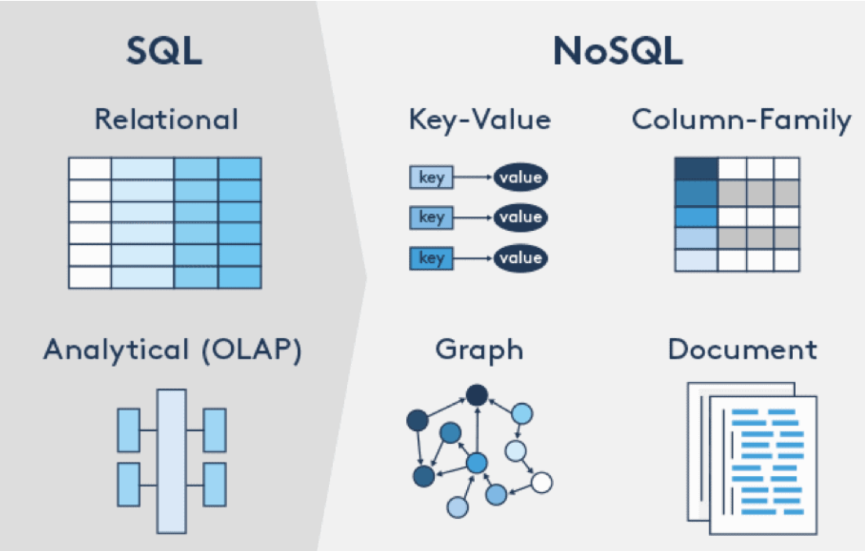
Redis is NoSQL

Slide 4
What is Redis?
Redis is an in-memory data structure store
Redis can be used as an in-memory key-value database, a caching layer, and a message broker
All Redis data resides in memory, which enables low latency and high throughput data access.
Redis can support different kinds of abstract data structures such as strings, hashes, lists, stored sets, maps, bitmaps, streams…
Redis is usually built on top of a traditional database
With Redis Enterprise, you can use Redis as both an in-memory cache and a primary database in a single system

Slide 5
Benefits of Redis
Performance
All Redis data resides in memory, which enables low latency and high throughput data access.
Unlike traditional databases, In-memory data stores don’t require a trip to disk, reducing engine latency to microseconds.
Simplicity and ease-of-use
Enables you to write traditionally complex code with fewer, simpler lines
Simpler command structure as opposed to the query languages of traditional databases
Replication
supports asynchronous replication where data can be replicated to multiple replica servers, Providing improved read performance and fast recovery

Slide 6

Persistence
Supports point-in-time backups (copying the Redis data set to disk)
High availability and scalability
Redis offers a primary-replica architecture in a single node primary or a clustered topology, allowing to build highly available solutions providing consistent performance and reliability
Allows to adjust the cluster size, thus, the cluster can grow based on your demands
Open source
no vendor or technology lock
The community includes AWS
Flexible data structures

Slide 7
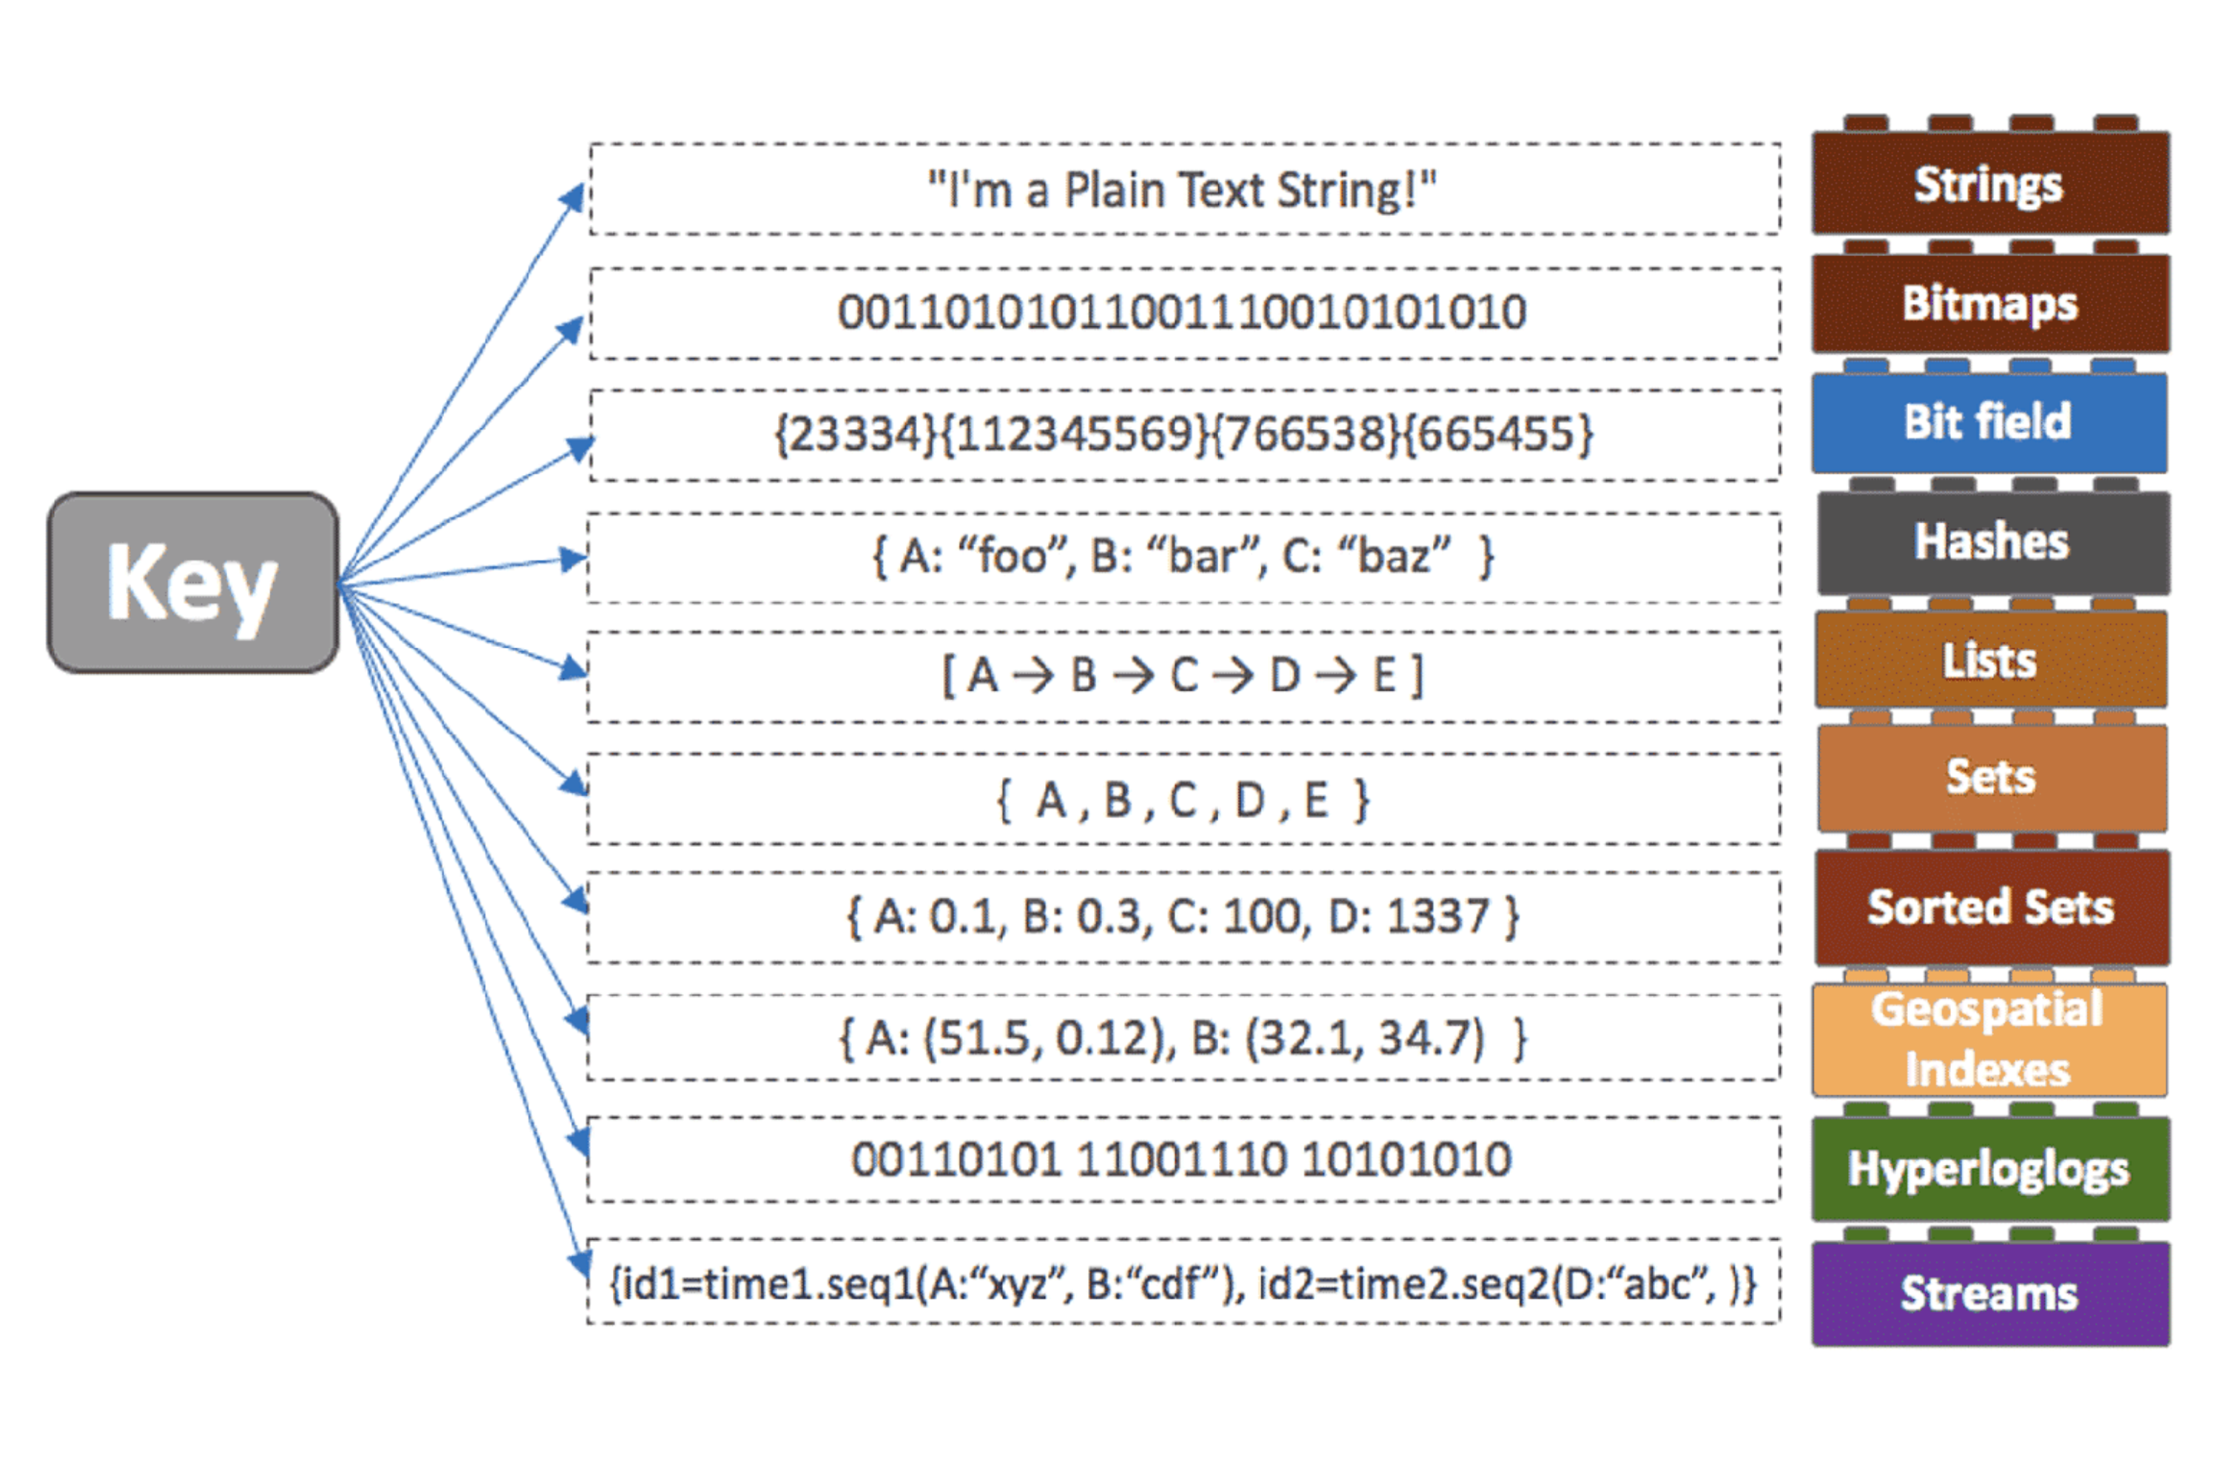
Redis data types

Slide 8
Redis Use Cases
Caching
Redis is a great choice for implementing a highly available in-memory cache to decrease data access latency, increase throughput, and ease the load off your relational or NoSQL database and application
Redis can serve frequently requested items at sub-millisecond response times, and enables you to easily scale for higher loads
Chat, messaging, and queues
Redis supports Pub/Sub with pattern matching
Redis to support high performance chat rooms, real-time comment streams, social media feeds and server intercommunication.
Session Store
popular choice among application developers to store and manage session data for internet-scale applications.

Slide 9
Rich media streaming
Redis offers a fast, in-memory data store to power live streaming use cases
Redis can be used to store metadata about users' profiles and viewing histories, authentication information/tokens for millions of users
Geospatial
Redis can manage real-time geospatial data at scale and speed
You can use Redis to add location-based features such as drive time, drive distance, and points of interest to your application
Machine learning
Redis gives you a fast in-memory data store to build, train, and deploy machine learning models quickly
Real-time analytics
Redis can be used with streaming solutions such as Apache Kafka and Amazon Kinesis as an in-memory data store to ingest, process, and analyze real-time data with sub-millisecond latency

Slide 10
Redis Language Support
Go
C/C++/C#
Python
JavaScript
NodeJS
Java
PHP
Ruby
Perl

Slide 11
REDIS DEMO

Slide 12
